Slide 1



2025
PrivChat
A Secure Peer-to-Peer Communication Application
Presented by
K Shirisha – 22N81A6268
K Sai Tejaswini – 22N81A62A9
B Harish Gandhi – 22N81A62B3
K Dinesh Karthik – 22N81A62C0
Next Slide

Slide 2
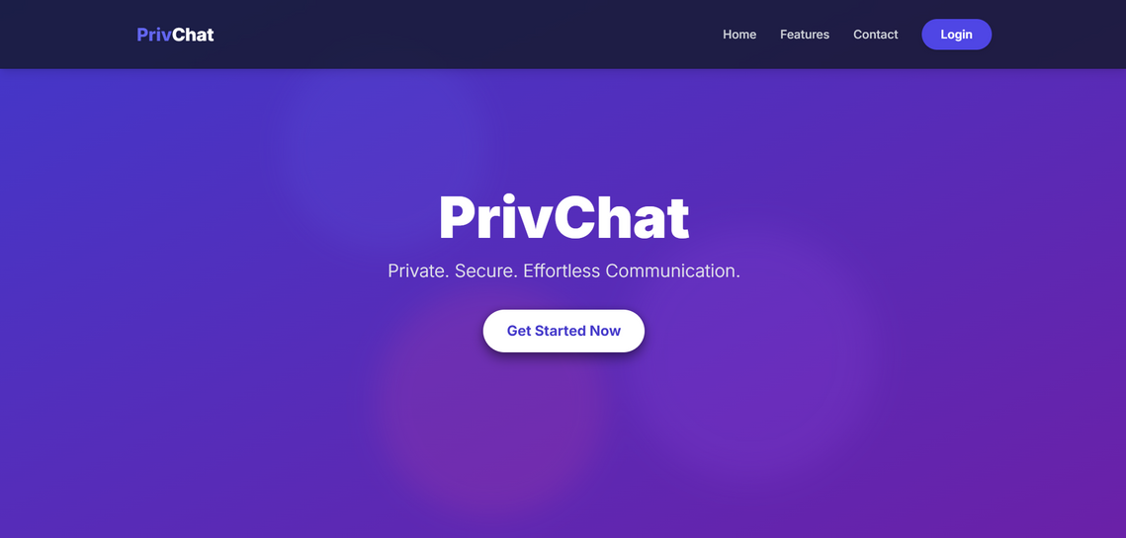
PrivChat
What is
PrivChat
PrivChat is a secure, private chat platform that allows you to connect with others in a controlled environment. You can create or join a chat room using a short PIN, and the room creator decides who gets in. Conversations happen directly between users with messages that vanish after you leave, keeping your chats confidential and temporary
Next Slide

Slide 3
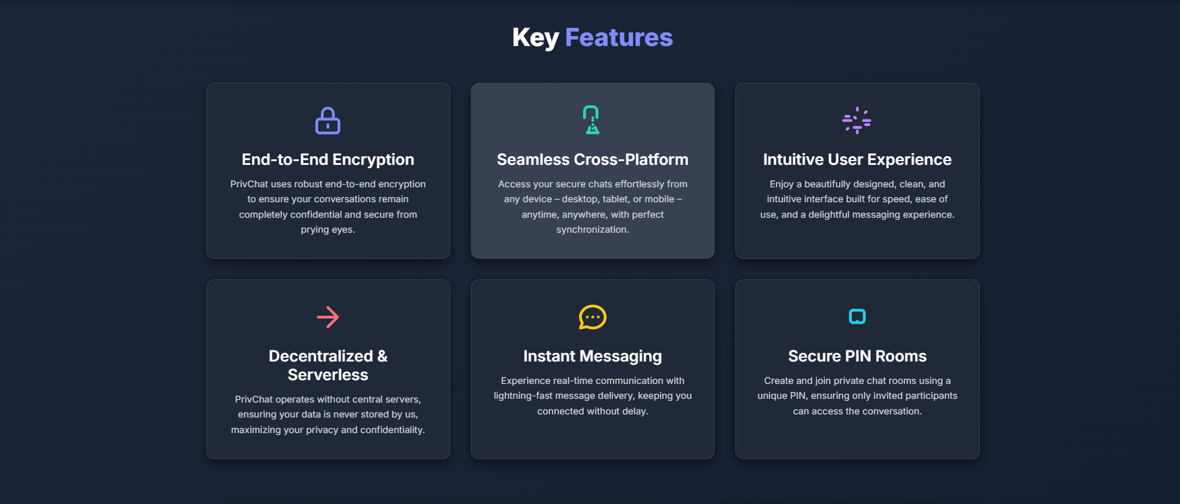
Key
Features
PrivChat
Next Slide

Slide 4
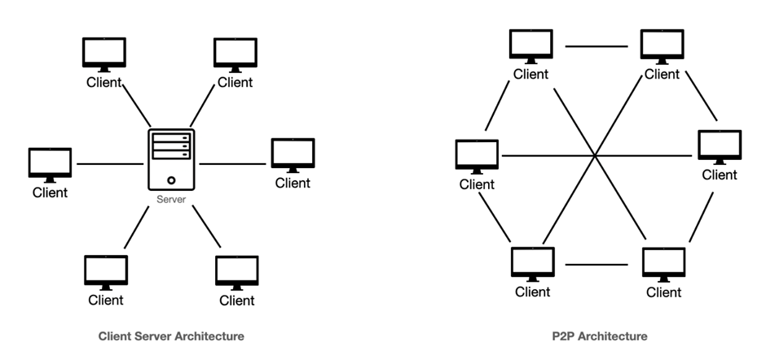
Domain Description
The digital communication sector has grown fast, uniting billions of people worldwide. But the growth has affected privacy. Common chat applications use a client-server paradigm, with a main server gathering messages from a user and sending them to another user. The system is straightforward and can scale, but it also brings privacy and security concerns. User data, including private conversations, is kept on the main servers and thus vulnerable to data leaks, unauthorized access by service providers, and government monitoring, as well as single points of failure. The need for privacy, integrity, and evidence in digital conversations has thus become high, especially for people and organizations dealing with sensitive information. This has generated a higher focus on decentralized and peer-to-peer (P2P) communication systems that strive to regain the users' control over data through direct communication.

Slide 5
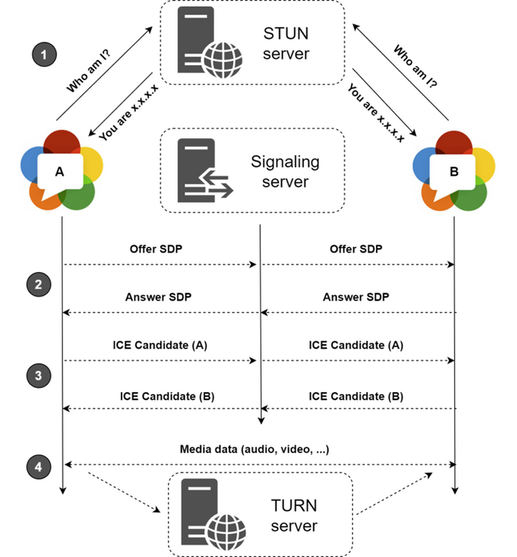
Literature
Survey
Most chat apps like WhatsApp and Telegram use a central server to send and sometimes temporarily store messages. Although these apps now use end-to-end encryption to keep what you say private, the server still knows details like who is talking and when. In contrast, WebRTC lets your browser connect directly to someone else's, so your messages, calls, or video chats go straight between you without a middleman handling the data. This direct connection makes your conversations even more private while still needing a little help at the start to connect everyone together.

Slide 6
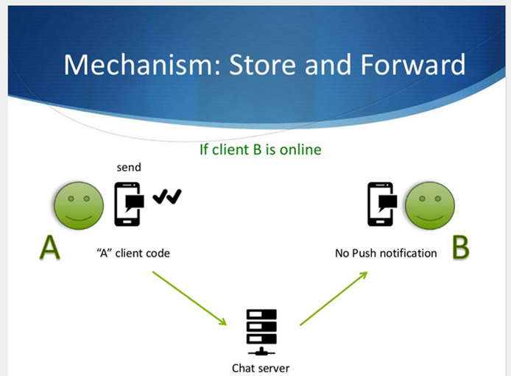
Existing System and Drawbacks
Existing System:
Centralized Chat Applications
Most chat applications (like WhatsApp, Discord, Slack, and Messenger) work on the client-server architecture.
Clients: Client devices (web browsers, mobile apps).
Server: A robust main server system belonging to and operated by the service provider.
How they typically work:
When User A sends a message to User B:
User A's customer sends the message to the main server.
The primary server accepts, handles, and usually keeps the message (at least temporarily, sometimes indefinitely).
The main server then forwards the message to User B's client.
Disadvantages:
Interception
Failure
Trust
Latency
Bandwidth

Slide 7

Proposed System and Advantages
PrivChat: A Hybrid P2P Communication System
PrivChat ensures secure and private communication by blending a central server for authentication and signaling with direct peer-to-peer data channels.
Authentication & Signaling Server (Node.js)
Handles user accounts with bcrypt-secured passwords.
Authenticates sessions via express-session.
Enables peer discovery and connection negotiation using WebSockets (relaying WebRTC offers, answers, and ICE candidates).
Manages chat room creation and approvals.

Slide 8
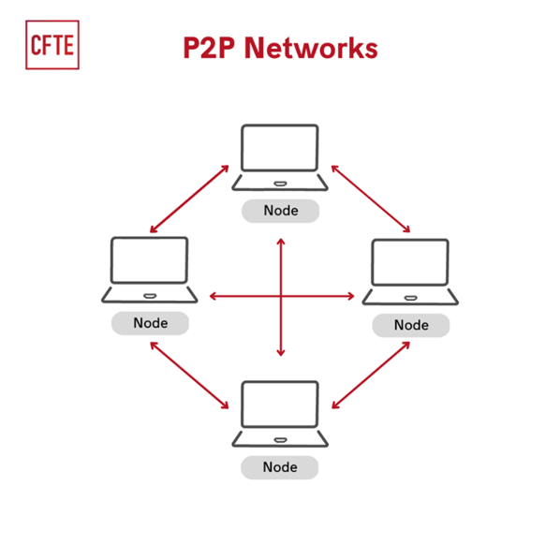
Peer-to-Peer Data Channel
Establishes direct browser-to-browser communication via WebRTC DataChannels after signaling.
Ensures all chat messages flow privately without passing through a central server.

Slide 9
PrivChat
Absolute Data Privacy
Enhanced Security
Chat messages are sent directly between peers, eliminating any chance of centralized data interception.
Mandatory DTLS encryption in WebRTC secures every data packet exchanged between endpoints.
PrivChat
Advantages
Reduced Server Burden
Minimized Trust Requirement
The server only manages authentication and signaling, which optimizes system scalability.
Users need to trust the server only for connection setup, as all message exchanges thereafter occur privately.

Slide 10
Software Requirements
Operating System: Windows, Linux, macOS (for both server and client development/deployment).
Backend Environment:
Node.js: Runtime environment (LTS version recommended, e.g., v18.x or v20.x).
npm (Node Package Manager): For managing Node.js dependencies.
Express.js: Web framework for handling HTTP requests and routing.
ws: WebSocket library for real-time bidirectional communication (signaling).
bcrypt: Library for password hashing.
express-session: Middleware for session management.
mysql: Node.js driver for MySQL database interaction.
hbs (Handlebars.js): Templating engine for server-side rendering of views.
Requirements
Software & Hardware

Slide 11
Software Requirements
Database:
MySQL Server: Version 8.0+ recommended.
MySQL Client/Workbench: For database administration and schema management.
Requirements
Software & Hardware
Frontend Technologies:
HTML5, CSS3, JavaScript: Standard web technologies for client-side development.
Bootstrap 5.3: CSS framework for responsive and modern UI components.
WebRTC API (Browser Support): Essential for establishing peer-to-peer data channels. Modern web browsers (Chrome, Firefox, Edge, Safari) typically have strong WebRTC support.

Slide 12
Hardware Requirements
Server (for Signaling and Authentication):
Processor: Quad-core CPU or higher.
RAM: 8GB RAM or more.
Storage: 250GB SSD (for OS, Node.js, MySQL, and logs).
Network: Stable internet connection with sufficient bandwidth.
Requirements
Software & Hardware
Client (User Devices):
Processor: Dual-core CPU or higher.
RAM: 4GB RAM or more.
Storage: Minimal, as chat data is not stored locally by the application.
Network: Stable internet connection.
Webcam/Microphone (Optional): Not required for the current chat-only functionality, but would be needed for future video/audio call features.

Slide 13
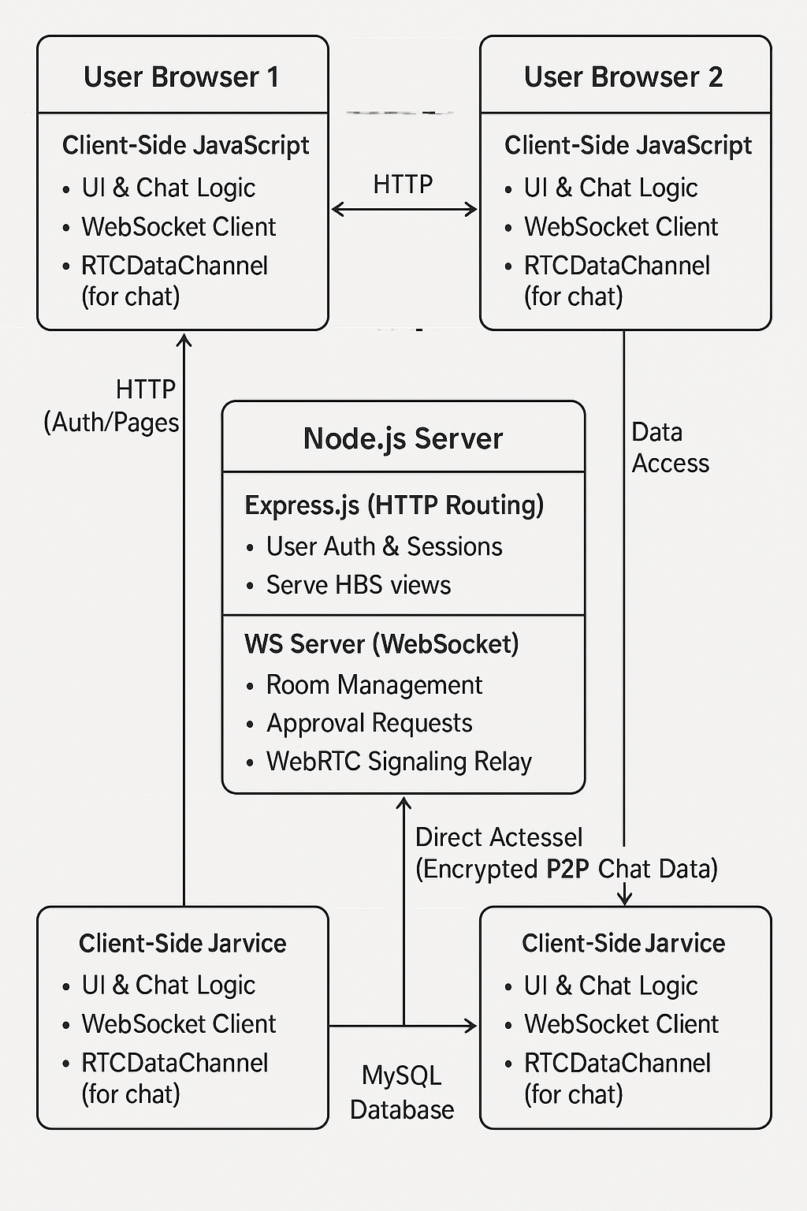
PrivChat Architecture
Hybrid Architecture:
PrivChat leverages a server for authentication/signaling and direct P2P channels for chat, ensuring no intermediate server data is ever transmitted.
Client Layer (Browser):
The web app (HTML, CSS, JavaScript) initiates HTTP for auth/pages, establishes WebSocket connections for signaling, and sets up secure WebRTC DataChannels for direct chat.
Server Layer (Node.js/Express/WS):
The server handles user authentication, session management, room approvals, and relays signaling messages without processing or storing actual chat data.
Database Layer (MySQL):
Securely stores user credentials and details, with access restricted to the Node.js server for necessary authentication operations.
This structure encapsulates the architectural layers and data flow (Phase 1: Authentication & Signaling; Phase 2: Direct P2P communication) neatly into one slide.

Slide 14
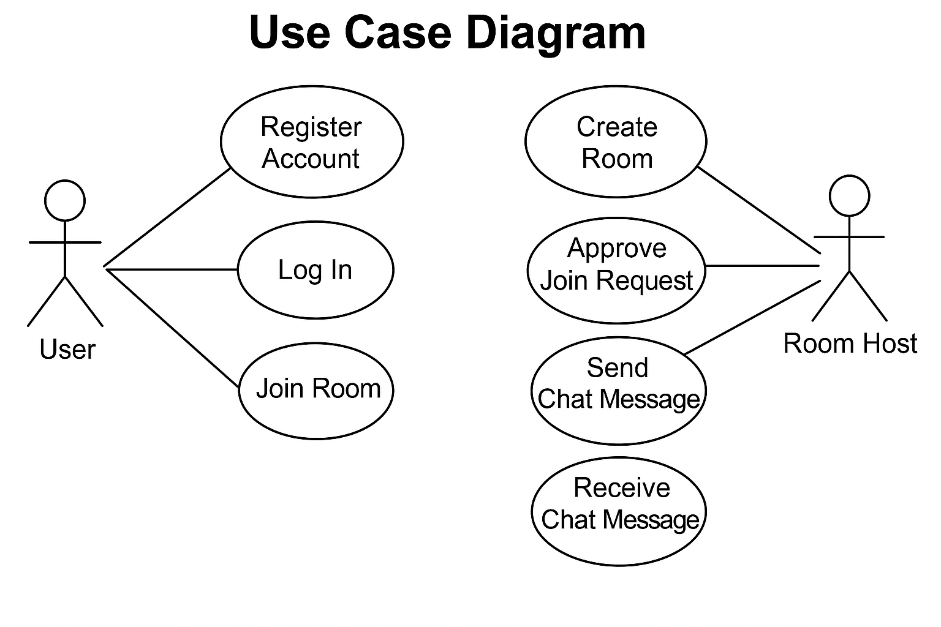
UML DIAGRAMS
UML Diagrams for PrivChat
1. Use Case Diagram:
Actors: User, Room Host.
Use Cases: Register Account, Log In, Log Out, Create Room, Join Room, Approve Join Request, Send Chat Message, Receive Chat Message.
Purpose: Illustrates the functional requirements of the system from the user's perspective.

Slide 15
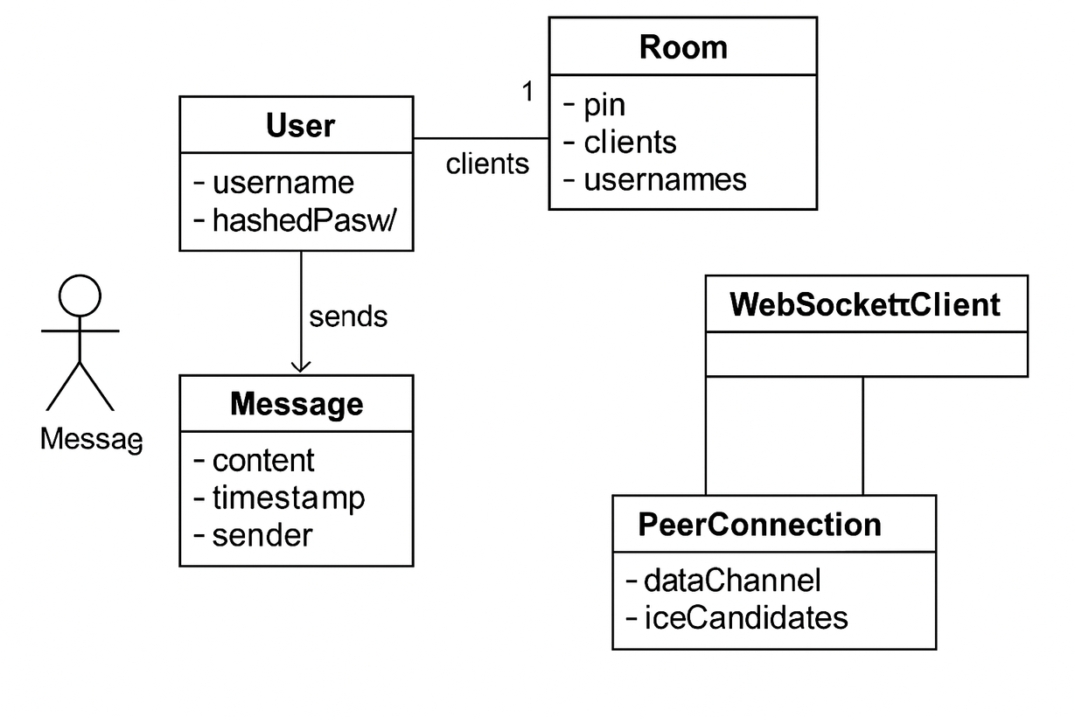
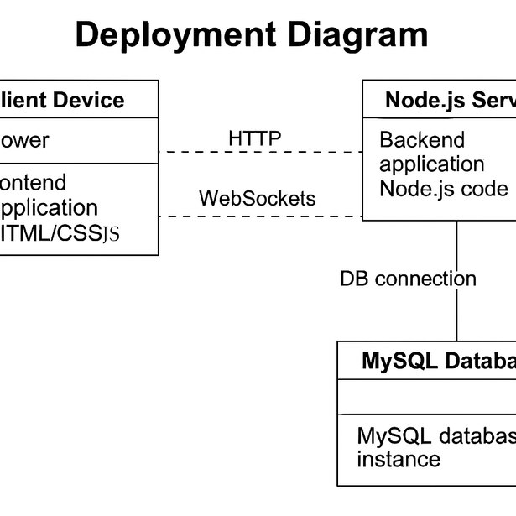
Class Diagram
Deployment Diagram
Classes (conceptual): User, Room, Message (client-side representation), WebSocketClient, PeerConnection.
Attributes: Relevant data fields for each class (e.g., User: username, hashedPassword; Room: pin, clients, usernames).
Relationships: Associations between classes (e.g., a Room has Clients, a User sends Messages).
Purpose: Shows the static structure of the system's objects, their attributes, and relationships.
Nodes: Client Device (Browser), Node.js Server, MySQL Database.
Components/Artifacts: Frontend application (HTML/CSS/JS), Backend application (Node.js code), MySQL database instance.
Connections: Represents network connections (HTTP, WebSockets, DB connection).
Purpose: Shows the physical deployment of software components on hardware nodes.

Slide 16
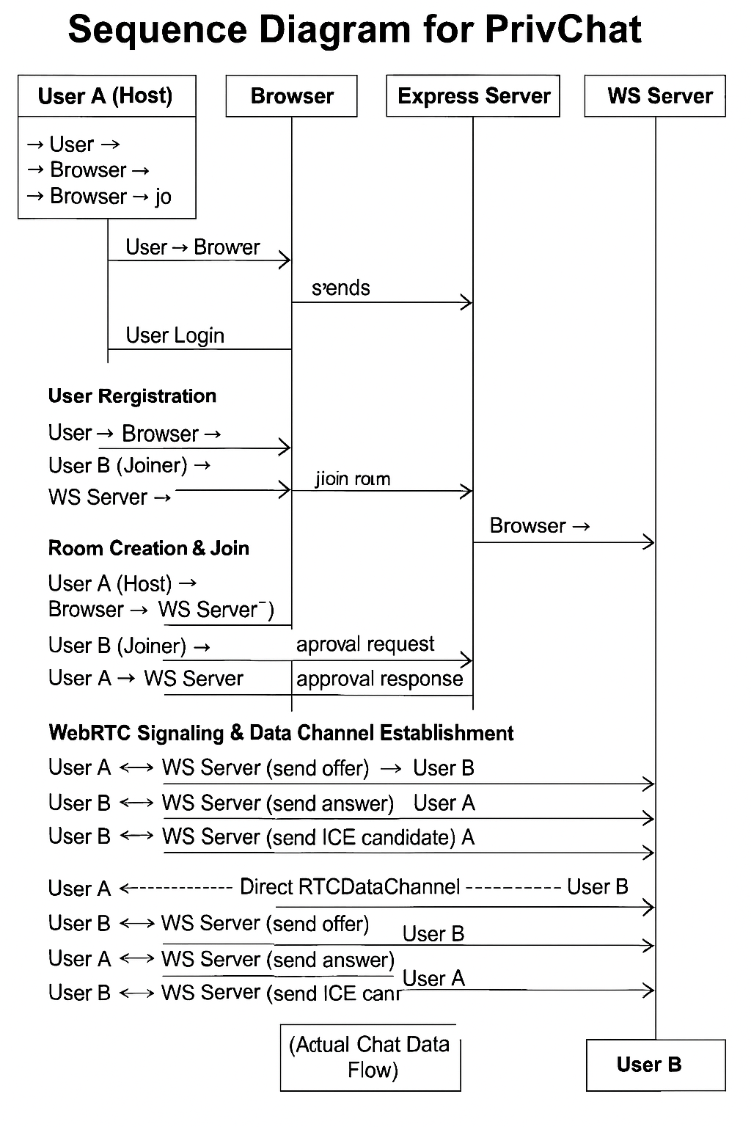
Sequence Diagram
User Registration:
User → Browser → Express Server → MySQL DB → Express Server → Browser
User Login:
User → Browser → Express Server → MySQL DB → Express Server → Browser
Room Creation & Join:
Host (User A): Browser → WS Server (create room)
Joiner (User B): Browser → WS Server (join room)
Approval Flow: WS Server → User A (approval request) → WS Server (approval response) → User B (approval result)
WebRTC Signaling & DataChannel:
User A ↔ WS Server (send offer) → User B
User B ↔ WS Server (send answer) → User A
Both exchange ICE candidates via WS Server
Direct RTCDataChannel is established for actual chat data
Purpose:
Demonstrates the order of interactions between system components over time.

Slide 17

PrivChat
Implementation
Algorithm
Coding
Testing

Slide 18
Algorithms
Password Hashing (Bcrypt):
Uses an adaptive key derivation function where a random salt is generated and combined with the user’s password; the salted input is hashed with a configurable cost factor (typically 10) and stored (including the salt). Login verification is done by re-hashing the input password via bcrypt.compare().
WebRTC Signaling:
Sets up a P2P connection via an offer/answer exchange using SDP (exchanging connection and codec details) followed by an ICE candidate exchange to find a viable network path, even behind NATs/firewalls.
Implementation
Algorithm

Slide 19
Coding
Backend (Node.js, Express, WS):
Language & Structure: JavaScript following the MVC pattern with middleware for session/authentication.
Database Interaction: Uses the mysql module with secure asynchronous queries (via prepared statements).
WebSocket Handling: Employs the ws library to manage connections and route messages between clients.
Frontend (HTML, CSS, JavaScript, HBS):
Languages & Styling: HTML for layout, CSS with Bootstrap for responsive design, and JavaScript for dynamic interactivity.
WebRTC Implementation: Sets up RTCPeerConnection and RTCDataChannel for direct P2P communication using WebSocket signaling.
Templating: Utilizes Handlebars.js (.hbs files) for integrating dynamic server data into the HTML.
Implementation
Coding

Slide 20
Testing
Unit Testing:
Each module and function (bcrypt utilities, database queries, WebSocket parsing) is individually tested to confirm expected behavior.
Integration Testing:
Validate client-server flows (login, registration, page rendering), WebSocket signaling (room creation/join, approval, and ICE exchange), and critical P2P communications (direct RTCDataChannel message transfer between peers).
Manual Testing:
Simulate diverse user scenarios (host actions, guest interactions, multiple join attempts, sudden disconnections) to ensure robust and reliable system behavior.
Implementation
Testing

Slide 21

Outputs
Homepage
Homepage

Slide 22
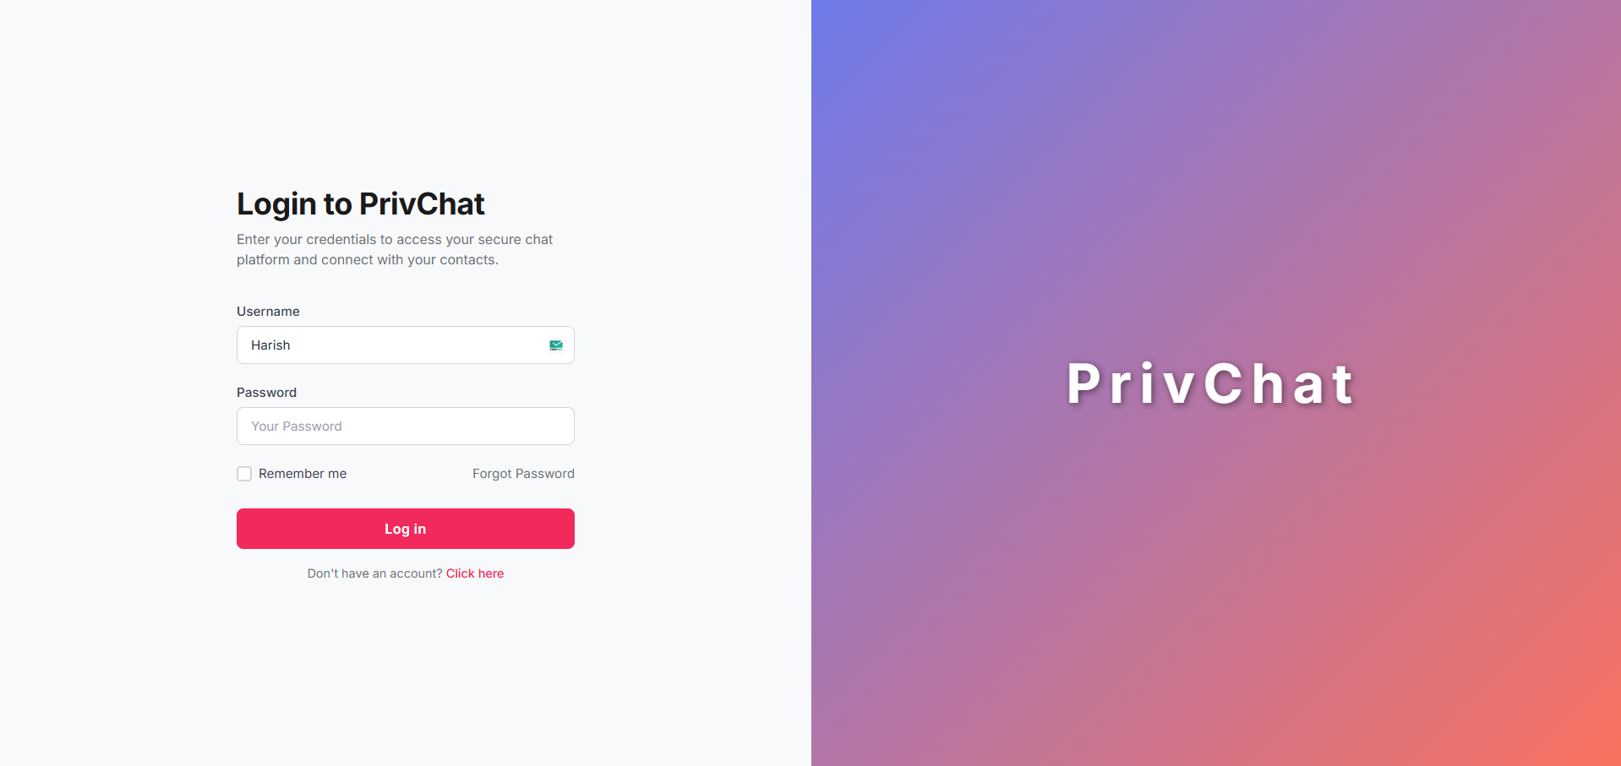
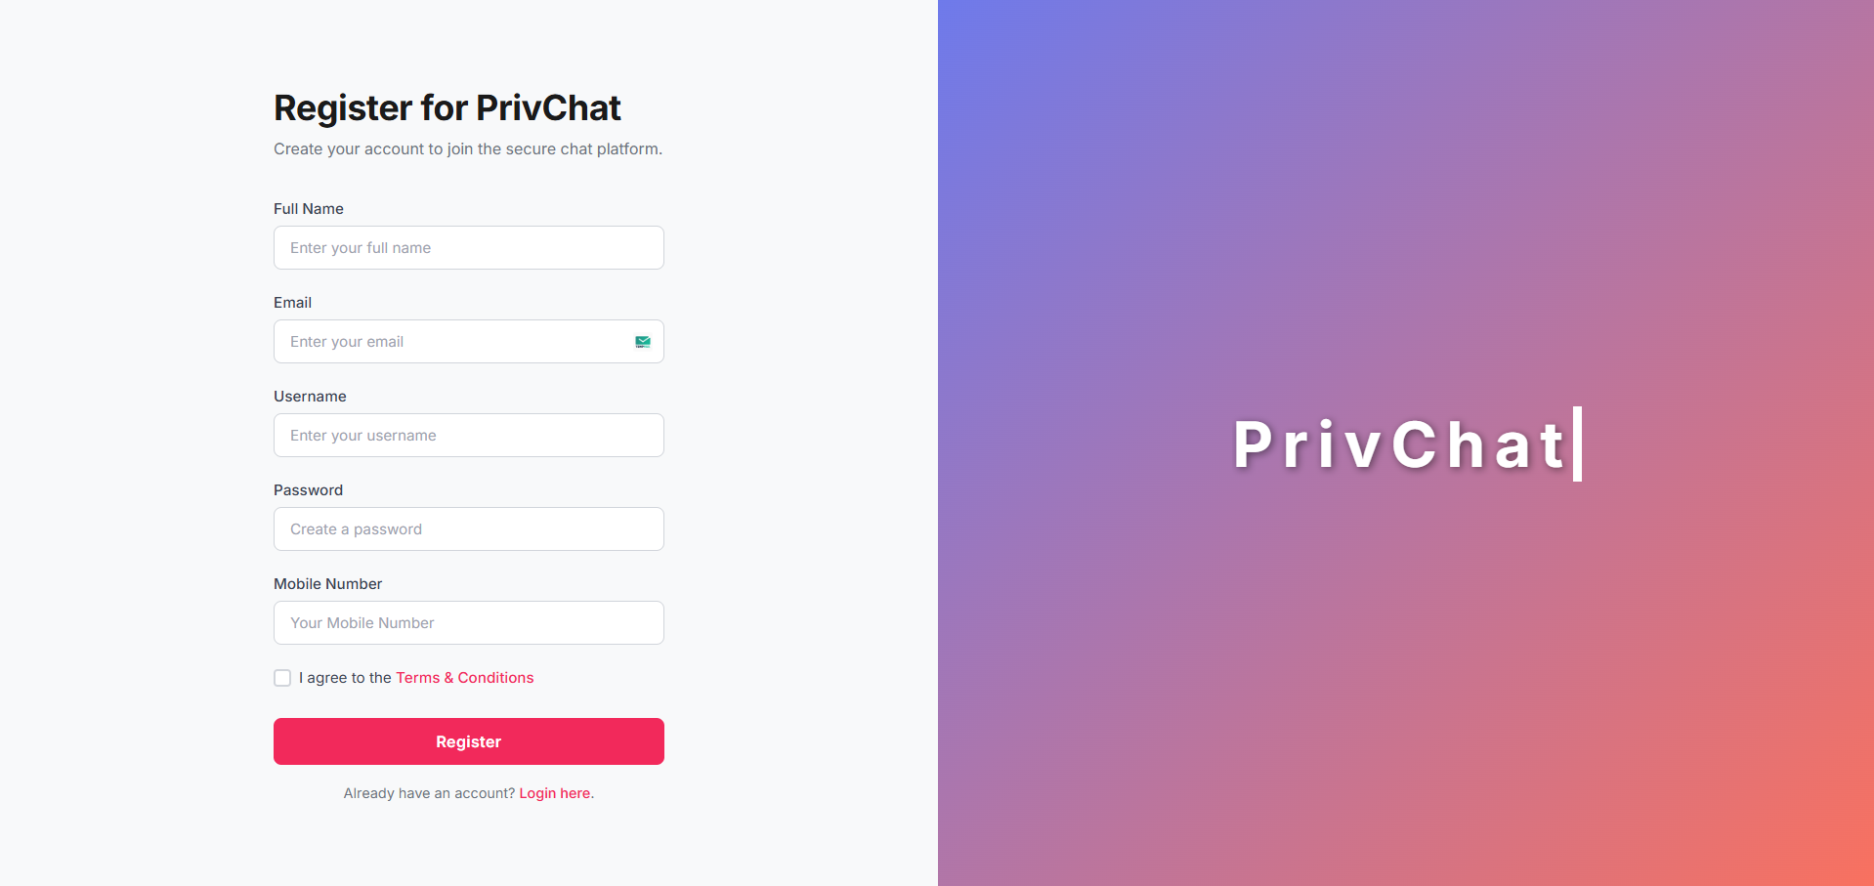
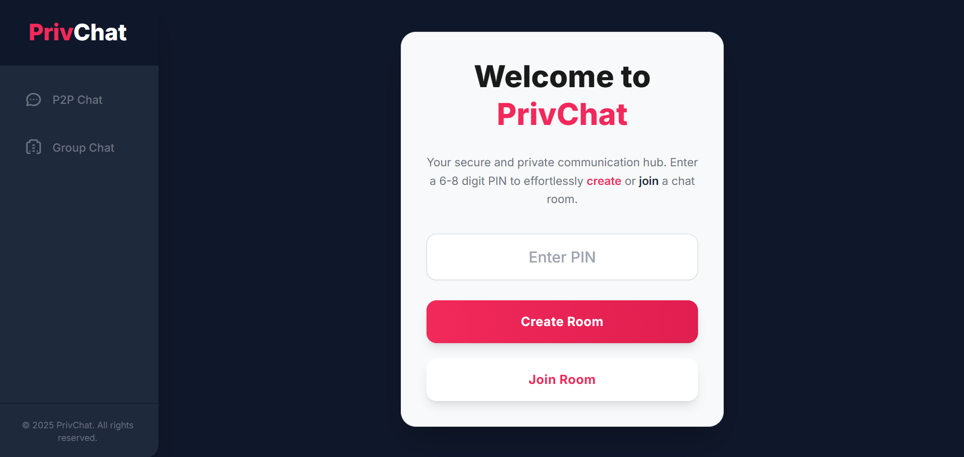
Login,
Registration&
Dashboard

Slide 23
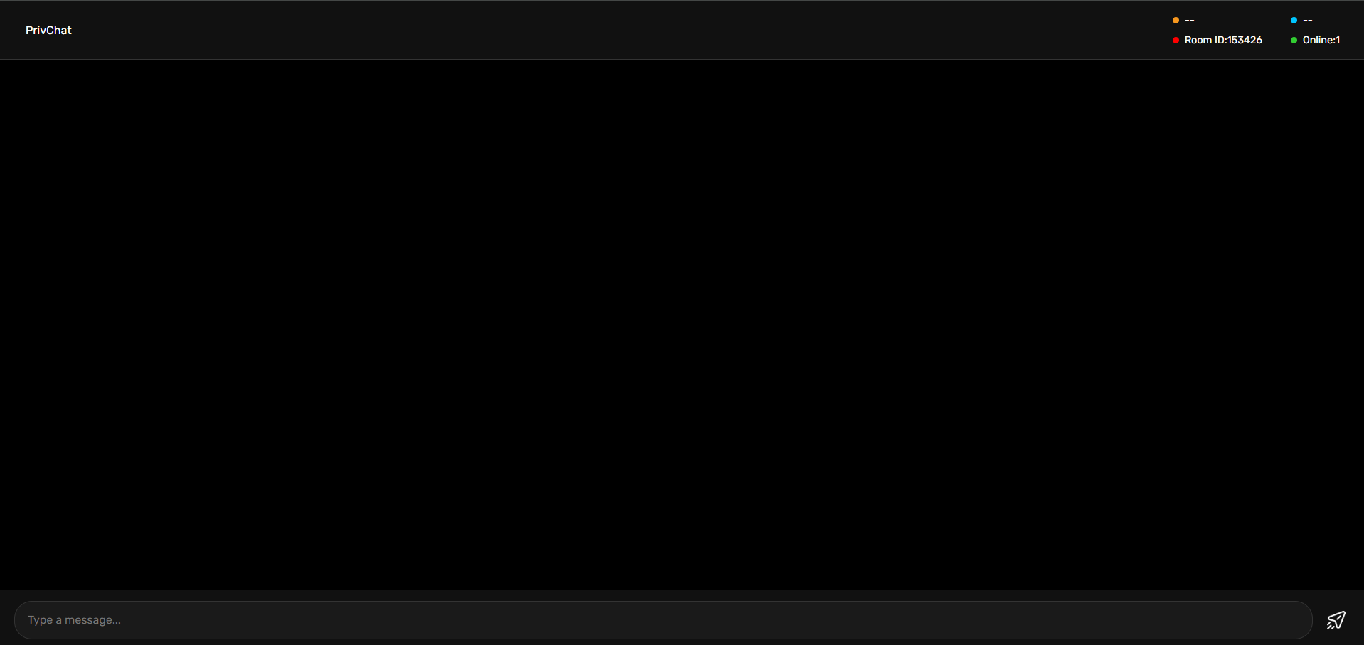
Chat Area

Slide 24
Conclusion & References
Conclusion:
PrivChat achieves robust privacy by restricting the server to authentication and signaling while leveraging WebRTC for secure, direct P2P communication, with bcrypt enhancing password security.
References:
Official Documentation:
Node.js Documentation: https://nodejs.org/en/docs/
Express.js Documentation: https://expressjs.com/
ws (WebSocket) Library Documentation: https://github.com/websockets/ws
bcrypt.js Documentation: https://www.npmjs.com/package/bcrypt
express-session Documentation: https://www.npmjs.com/package/express-session
MySQL Official Documentation: https://dev.mysql.com/doc/
WebRTC API Documentation (e.g., MDN Web Docs): https://developer.mozilla.org/en-US/docs/Web/API/WebRTC_API
Full resource available on github account reach it out, for full step by step guide for installation and working https://github.com/Harish2B3/PrivChat

Slide 25
PrivChat
Thank
You!

